Slide 1
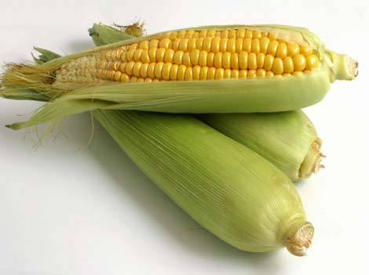
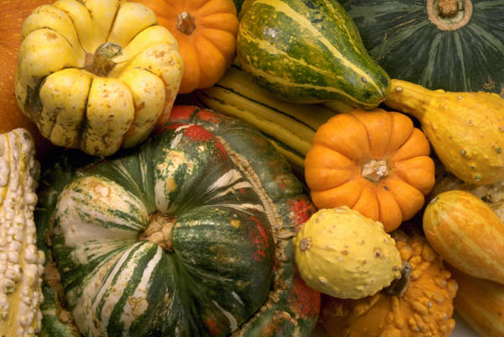
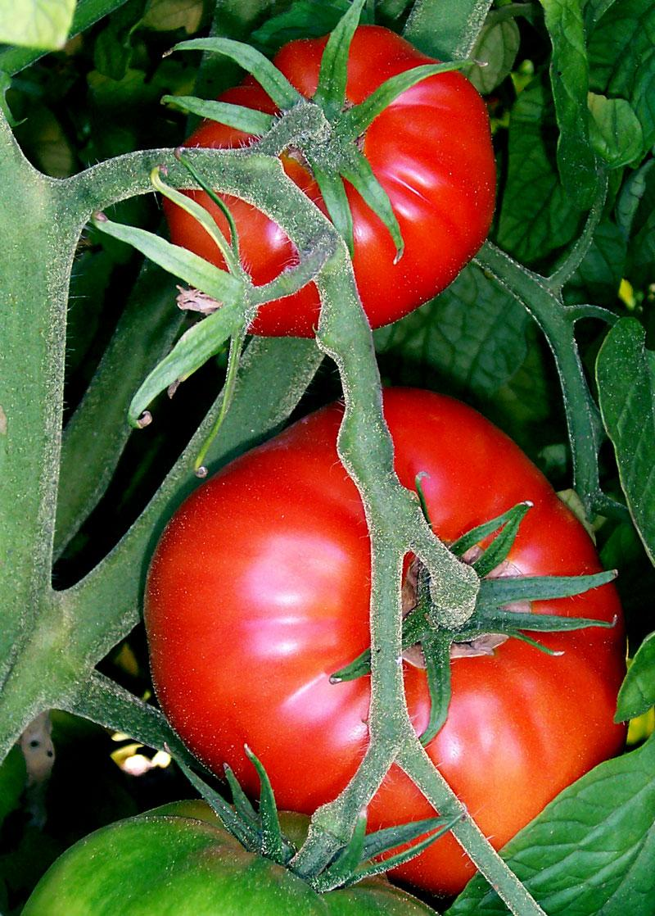
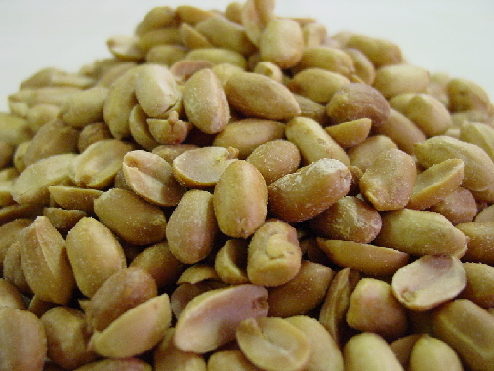
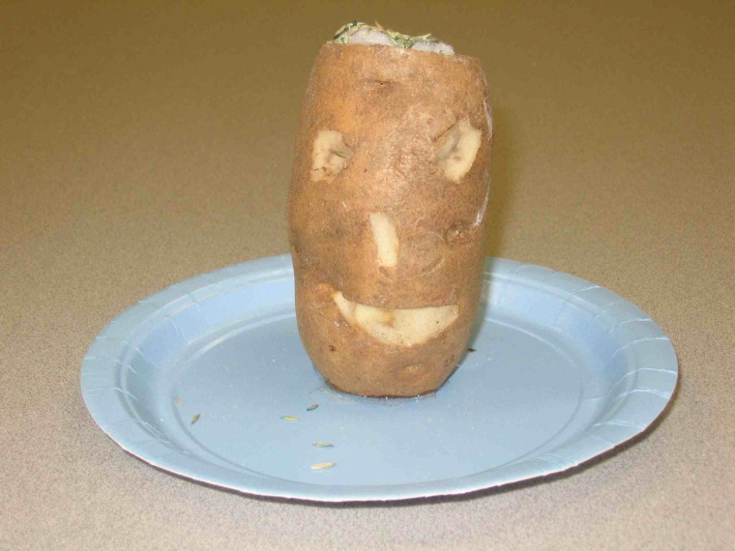
AIM: How did the 1492 encounter with Europeans affect Native Americans?
Do Now: What do these everyday foods have in common: corn, potatoes, tomatoes, squash, and peanuts?

Slide 2
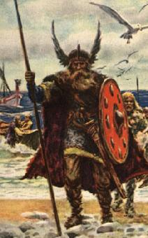
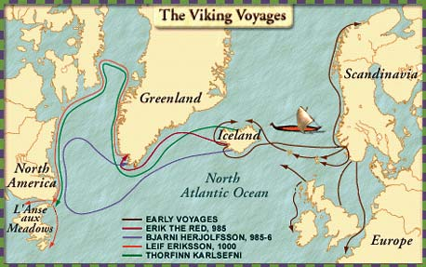
I. Early Contacts
A. Vikings- sailors led by Leif Eriksson reached present day Newfoundland in 1000 AD.
B. The settlement was brief and had little impact on Native Americans or the rest of the world.

Slide 3
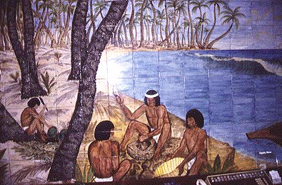
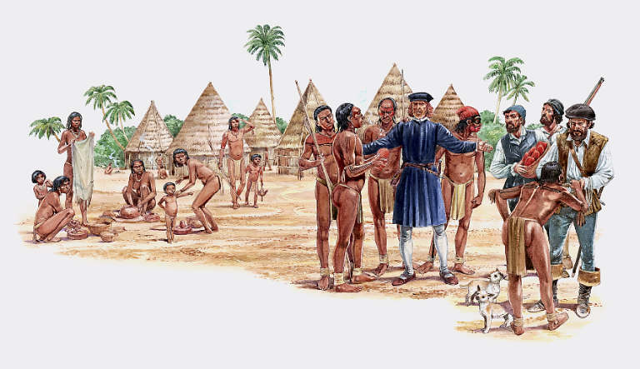
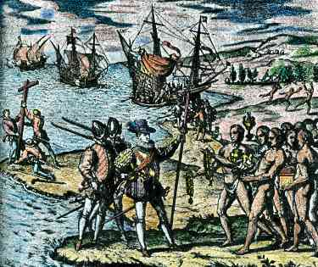
II. 1492
A. Columbus leads a Spanish fleet to the Bahamas- changed history forever.
B. Tainos were Native Americans he met there. Within 100 years, the entire Taino population was destroyed.

Slide 4
Where We Think Things Came From
New World Old World
Plants
Animals
Diseases
Ideas
Technology

Slide 5
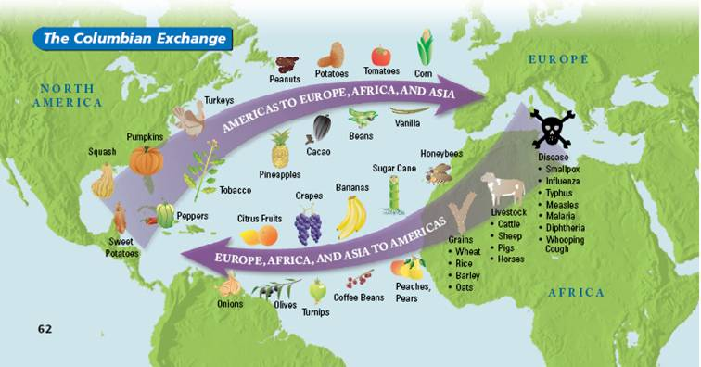
III. Columbian Exchange- the exchange of goods and ideas between Europeans and Native Americans- in both directions.

Slide 6
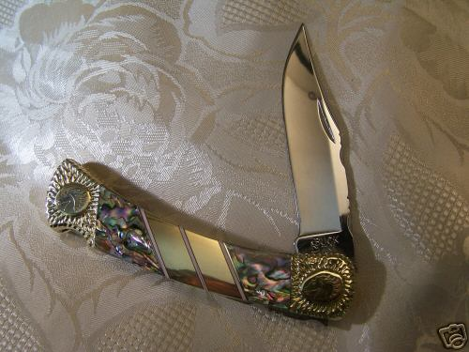
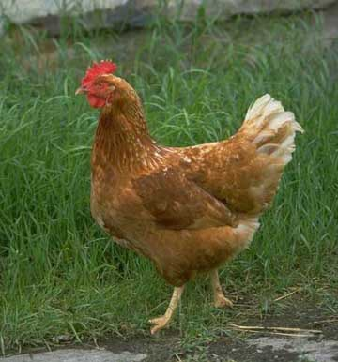
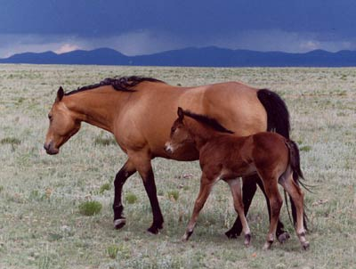
A. Europeans gave the following to Native Americans: (Old to New)
1. Domestic animals such as chicken and horses
2. Metals such as copper pots and knives
3. Produce such as sugar cane, banana, onion, watermelon
4. New diseases like smallpox

Slide 7
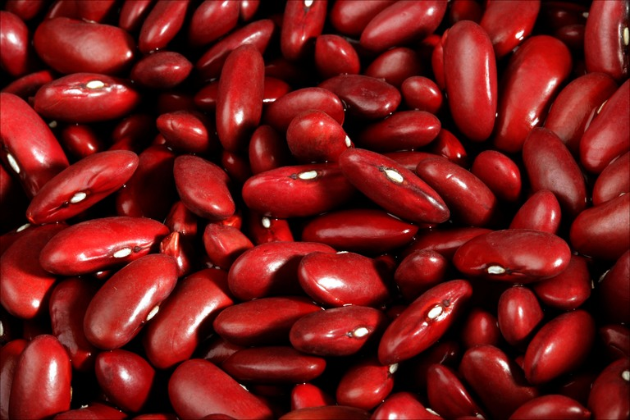
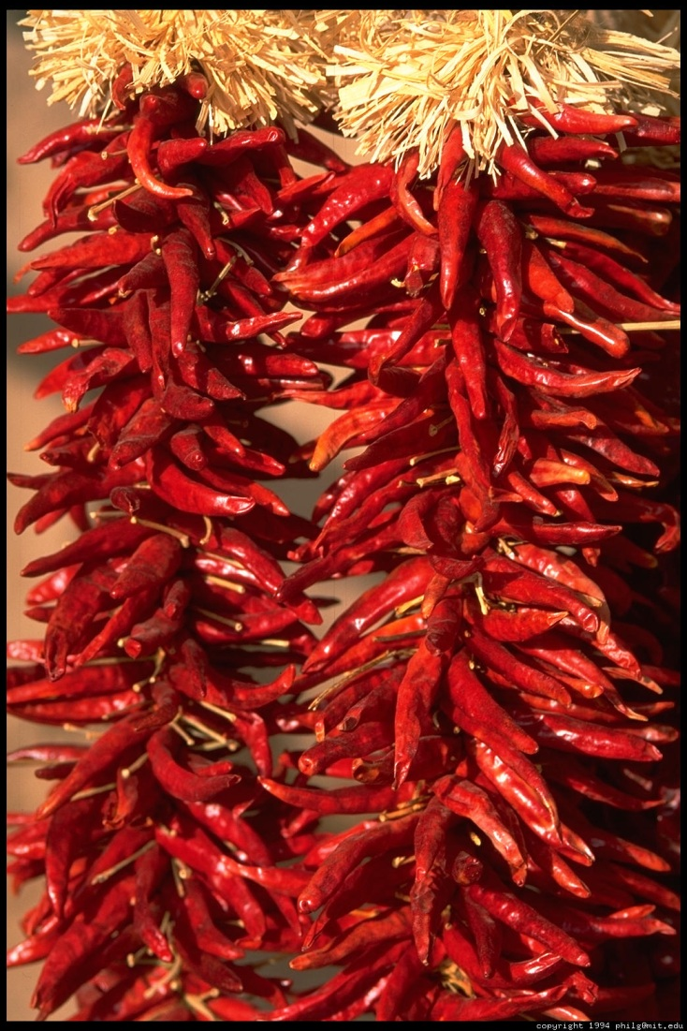
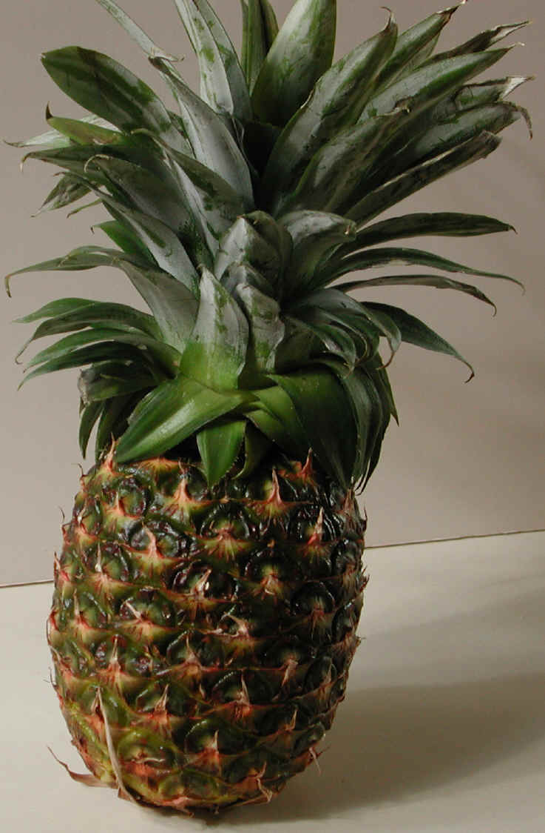
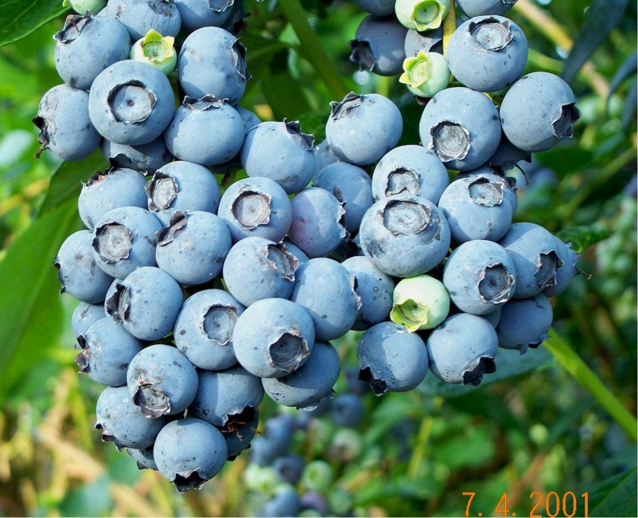
B. Native Americans gave the following to Europeans: (New to Old)
1. Food: corn, potatoes, beans, tomatoes, squash, peanuts, pineapples, blueberries, tobacco, chili peppers

Slide 8
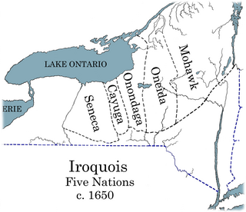
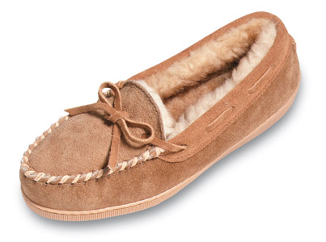
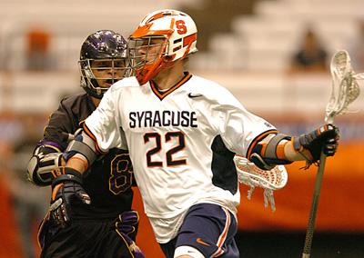
2. Language: poncho, moccasin, hickory tree, pecan, Massachusetts, Setauket, Patchogue, Montauk, Texas
3. Sports: Lacrosse
4. Government: Ben Franklin saw the League of the Iroquois as a model and urged Americans to unite in a similar way

Slide 9
Major Crops Around the Ancient World
Area | Cereals/Grasses | Seeds | Fiber | Roots, Leaves, Tubers | Fruits
Fertile Crescent | Wheat, barley | Pea, lentil, chickpea | flax |  | grapes
China | Millet | soybean | hemp |  | orange
Meso-america | Corn | green bean, chocolate | Cotton, yucca | jicama | Squash, tomatoes
South America | Quinoa (Andes) | Lima bean | cotton | Potato, peanut, tobacco, sweet potato | squash
West Africa | Sorghum, rice, millet | Black-eyed pea |  | African yams | watermelon
India | rice | Hyacinth bean | flax | onion | cucumber
Ethiopia | millet | coffee
U.S | barley | sunflower |  | artichoke | Squash, berries
New Guinea | Sugar cane |  |  | yams

Slide 10
Domestication of Animals
Species | Dates (B.C.) | Place
Dog | 10,000 | Southwest Asia, China, North America
Sheep | 8,000 | Southwest Asia
Goat | 8,000 | Southwest Asia
Pig | 8,000 | China, Southwest Asia
Cow | 6,000 | Southwest Asia, India
Horse | 4,000 | Ukraine
Donkey | 4,000 | Egypt
Water Buffalo | 4,000 | China
Turkey | 3,500 | Mesoamerica
Llama/Alpaca | 3,500 | Andes
Bactrian Camel | 2,500 | Central Asia
Arabian Camel | 2,500 | Arabia
*Information on major crops and domestication of animals from https://utah.agclassroom.org

Slide 11
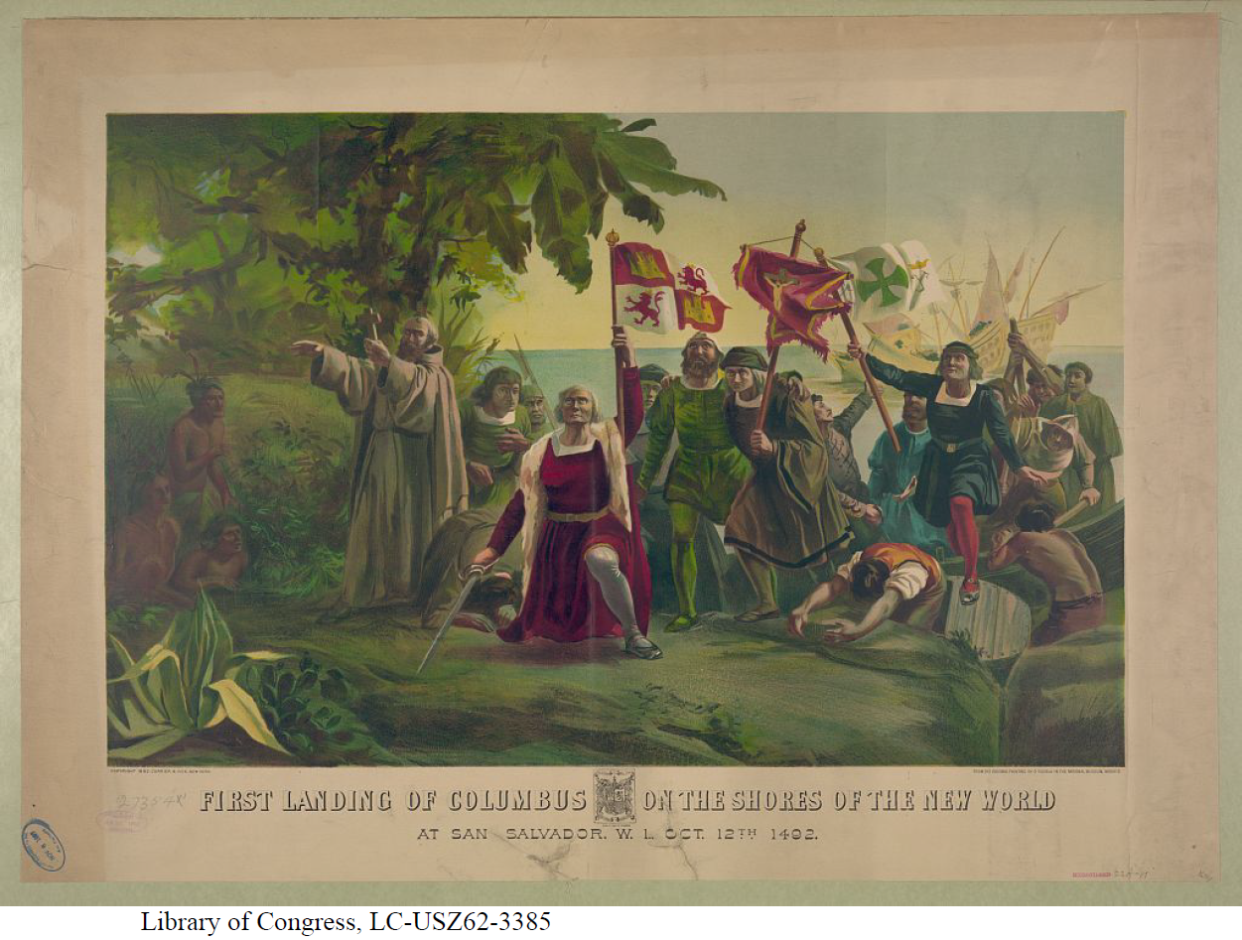

Slide 12
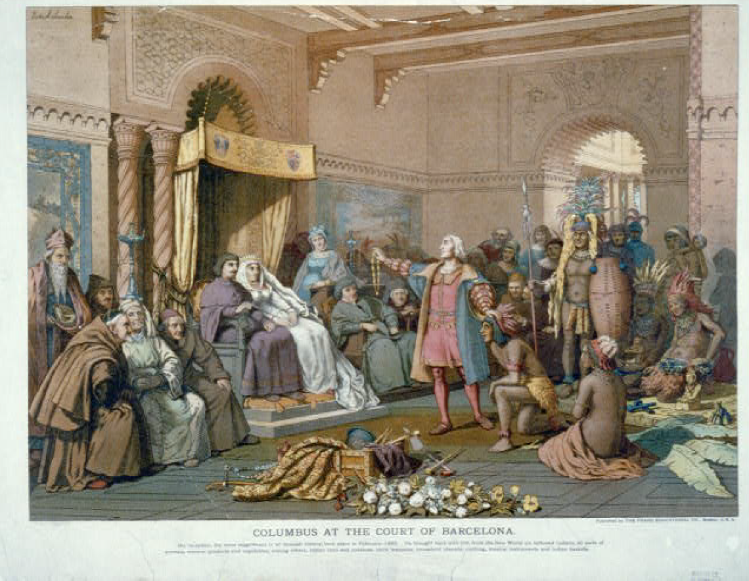

Slide 13
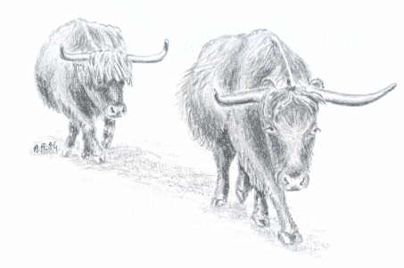
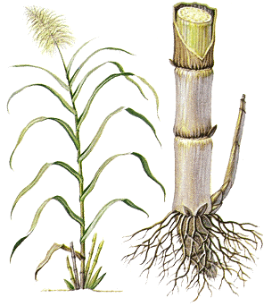
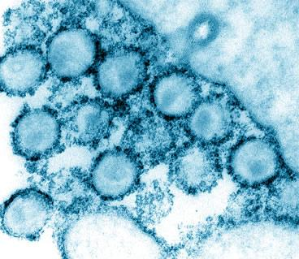
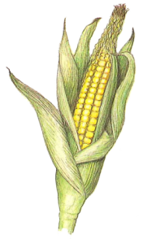
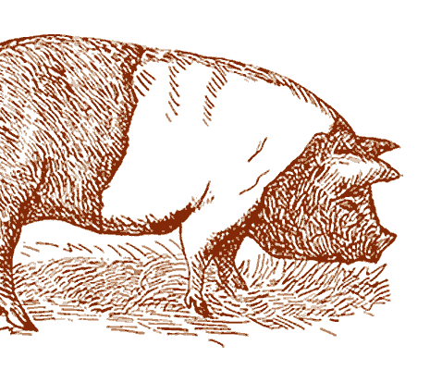
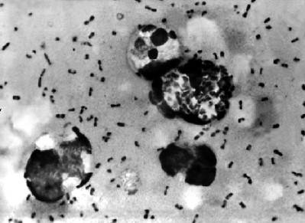
Your task
You are a research analyst who has been asked to research the origin of an organism, evaluate its impact on the receiving world, and present your findings to leading historians. Include information that will demonstrate this organism’s relevance to the receiving world.
Describe typical uses of plant/animal OR describe the disease (symptoms/cures).
Describe impact on the receiving world.
Interesting facts you discovered
If a disease, is it a threat to us today? If so, where (how widespread)?

Slide 14
Graffiti Activity
Respond to the following question on the large post-its around the room (words or pictures):
How does cultural contact change the world?
Think about what we have learned about the Columbian Exchange – foods, animals, diseases, technology and ideas.
In addition, you must respond to at least 2 other posts.

Slide 15
Citations
Arth, Julia Brittain. “The Columbian Exchange.” 15 March 2012. http://www.darke.k12.oh.us/curriculum/SocialStudies/Columbian%20Exchange3.pdf
Utah Ag in the Classroom. “Understanding the Columbian Exchange Through Old World Foods and New World Foods.” 15 March 2012. https://utah.agclassroom.org/teachercenter/index.cfm?controller=main&action=lpsearch&key=lib&lpID=650&gid=9
Utah Ag in the Classroom. “Food, Land and People and World Civilizations.” 05 November 2012. https://utah.agclassroom.org/teachercenter/index.cfm?controller=main&action=lpsearch&key=lib&lpID=650&gid=9

