Slide 1
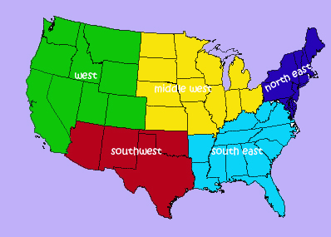
Geography and Regions of the United States

Slide 2
What is Geography?
Geography is the study of the earth’s surface; includes people’s response to topography, climate, soil, and vegetation.
It’s what the earth looks like
How people interact with the environment

Slide 3
Five Themes of Geography
The study of geography is categorized into five themes:
Movement
Region
Human-Environment Interaction
Location
Place

Slide 4
Movement
Movement relates to where resources are located and how they are transported to locations all over the earth.
It deals with how people, ideas, and things get from one place to another.
Movement helps us understand how we are connected and dependent upon other people and parts of the world.

Slide 5
Region
The earth is divided into different sections, based on certain shared traits.
Region may be based on :
Same Climate
Location
Language and culture
Landforms
Examples: the Middle East, Latin America, the Tropics

Slide 6
Human-Environment Interaction
This deals with how people interact with their surroundings.
People depend on their environment
People modify (change) the environment
People adapt to their environment

Slide 7
Location
Location answers the question: “Where is it?”
There are two types of location:
Relative location:
Location of a place compared to other places (ex., near the hospital, down the street, next to Harmon’s)
Absolute location:
This is the exact location of a place (ex., coordinates, address)

Slide 8
Place
This answers the question: “What is it like there?”
A place can be described by special characteristics
Characteristics can be human or physical
Human characteristics can include: Languages, holidays/traditions, clothing styles, political ideals, architecture
Physical characteristics are: mountains, oceans, rivers, climate, animals, vegetation

Slide 9
Class Outline
Northeast
South
Midwest
West

Slide 10
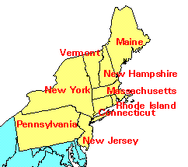
The Northeast
Northeast
Maine, New Hampshire, Vermont, Massachusetts, Connecticut, Rhode Island, New York, New Jersey, Pennsylvania, Delaware, Maryland, and the District of Columbia

Slide 11
Physical Geography of Northeast
Northern Appalachian mountains run through most of the northeastern states, causing little farmland, except in valley areas.
Deep bays exist, allowing for port towns.
Jagged, rocky coastline in northern areas.

Slide 12
Climate and Vegetation of Northeast: Humid Continental
No Dry Season- this area receives precipitation throughout the year.
Cold, snowy winters and hot summers.
Moderate growing season that decreases as you go north.
Vegetation is mixed forests with deciduous and coniferous trees.

Slide 13
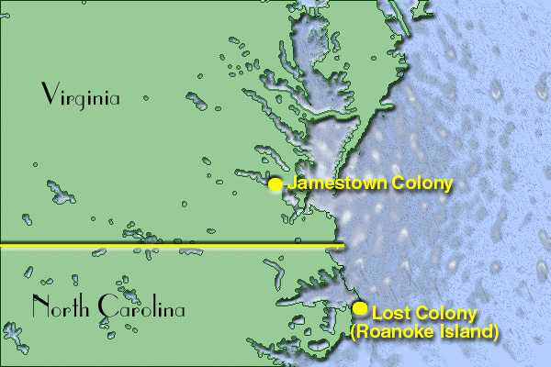
Historical Geography of the Northeast
The Northeast has the longest history of European settlement .
Historically, the Northeast has been the gateway to immigrants.
Established itself as the financial and manufacturing hub early in the industrial revolution.

Slide 14
Population Geography of the Northeast
Population is concentrated in the Megalopolis that runs from Boston to Washington (AKA Bosnywash).
This is the most densely populated region in the United States.

Slide 15
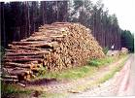
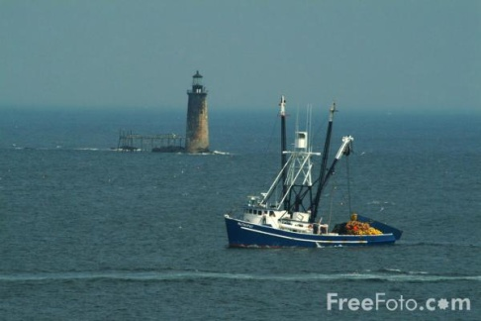
Land Use in the Northeast
Dairy Farming
Farming
Timber
Maritime Activity
Some Mining
Note: As you go north, the growing season shortens, which limits farming. In part of the Northeast, timber is a primary economic activity.

Slide 16
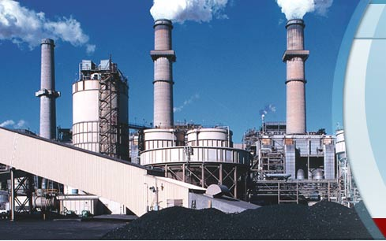
Economic Geography
Northeast is the heart of the Manufacturing core, but lately has been termed the RUST BELT. This extends into the Midwest.
Why do you think it’s called the Rust belt? Where have industries relocated? Why?

Slide 17
New England Legacy
New England is famous for its “prep schools” and is home to some of the most elite Universities in the world: Harvard, Yale, MIT, Boston College, Brown, and Dartmouth (just to name a few).
One of the best resources New England has is its educated population.

Slide 18
New England Politics
New England is generally progressive in politics and states usually are affiliated with the Democratic party, although some rural areas tend to vote Republican.

Slide 19
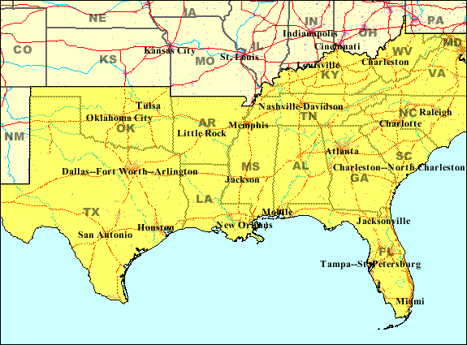
The South
States included: North Carolina, South Carolina, Florida, Georgia, Alabama, Mississippi, Tennessee, Arkansas, and Louisiana.
Transition States: Virginia, W. Virginia, Kentucky, Missouri, Oklahoma, and Texas

Slide 20
Climate and Vegetation of the South
Humid subtropical, with hot, humid summers and long growing season. Winters are mild, seldom with snow. There is no dry season.
Vegetation: Mixed forests. The South is known for plants such as live oaks, magnolia trees, flowering dogwoods.

Slide 21
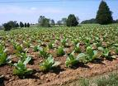
Economic Geography of the South
Historically based on agriculture, with tobacco and cotton being the first cash crops.
Fishing is a common activity in Gulf Coast States.
Tourism along the Gulf Coast, especially Florida.
Oil Industry is located in the Gulf and in cities like Houston and Beaumont, close to continental shelf drilling.

Slide 22
Political Activity
The South is known for its conservatism.
The Republican Party dominates the South as a result.
Resistance to same-sex marriage, abortion, feminism, desegregation, and the abolition of slavery are part of the political history of the South.

Slide 23
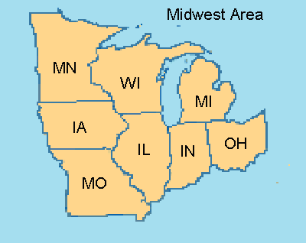
Midwest
Included States: Michigan, Ohio, Indiana, Illinois, Wisconsin, Minnesota, and Iowa
Transition States: Pennsylvania, Missouri

Slide 24
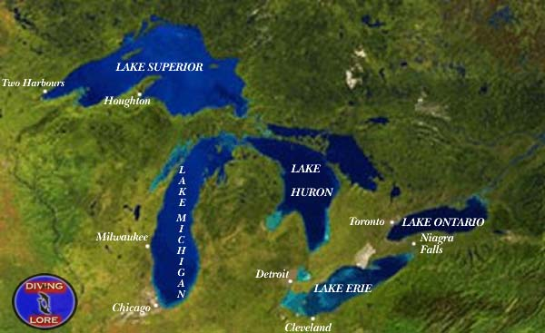
Physical Geography of Midwest
Flat landscape, with river basins.
Distinctive Great Lakes, which provide for shipping.

Slide 25
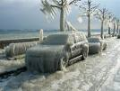
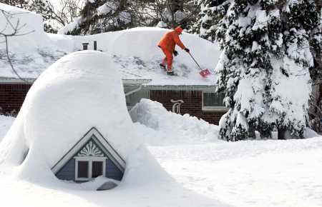
Climate of the Midwest: Humid Continental
No Dry Season- this area receives precipitation throughout the year.
Cold, snowy winters and hot summers.
Moderate growing season that decreases as you go north.
Vegetation is mixed forests with deciduous and coniferous trees.

Slide 26
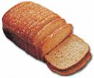
Historical Geography of the Midwest
The Mid-west was considered the “Western Frontier”, hence the name.
Historically known as the breadbasket of the U.S., as this is also an agricultural region.
Also known as a manufacturing, blue-collar hub of the U.S.

Slide 27
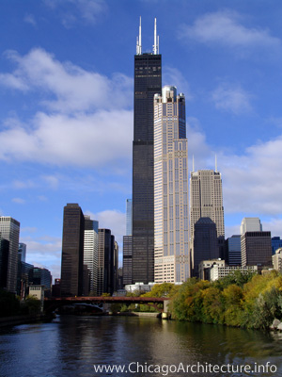
Population
Large cities include Chicago and Detroit
The region is evenly distributed.
Population is dense along the Great Lakes.

Slide 28
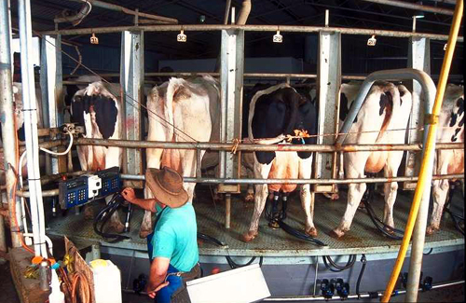
Economic Geography
Dairy Farming in Wisconsin and Minnesota
Fruit Orchards in Michigan
Corn in Indiana, Illinois, and Iowa
Manufacturing in urban cities along Great Lakes, like Pittsburgh, Cleveland, Detroit and Chicago (Steel Towns).

Slide 29
Breadbasket of the USA
Corn is most notably grown, but soybeans, wheat, and fruits orchards are also commonly found throughout the Midwest.
Dairy products are famous in which state in the Midwest?

Slide 30
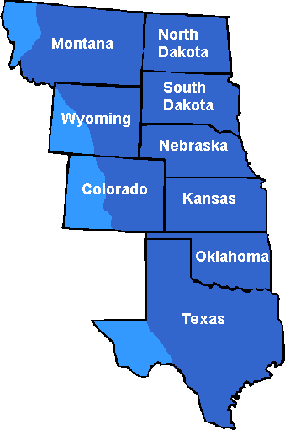
Great Plains Region
Strip of States through the center of the Country.
Includes: Kansas, Nebraska,
South Dakota, and North Dakota.
Transition States: Oklahoma,
Panhandle of Texas,
Eastern Colorado, Wyoming
and Montana.
,

Slide 31
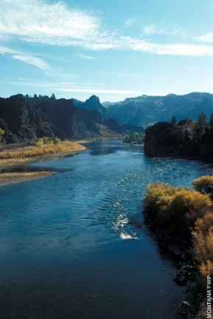
Physical Geography of the Great Plains
The Great Plains are also called the High Plains, as the elevation increases gradually as you go west.
Generally flat with some rolling hills.
Major River Basins: Red R., Arkansas River, Platte River, and the Missouri River.

Slide 32
Climate of the Great Plains
This area receives little rainfall (less than 18 in. a year on average).
Cold Winters, especially in the northern areas.

Slide 33
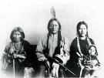
Historical Geography of the Great Plains
Before Americans settled the frontier, the Great Plains was home to several Indigenous culture, most notably the Sioux and the Cheyenne.
During the 19th century, the Great Plains became the staging point of war between the native people and the American settlers.

Slide 34
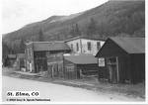
Homestead Act of 1862
This act provided each settler with 160 acres of land, as long as he cultivated the land.
This caused a rush of settlers to the Great Plains region in the 1800s.
Ironically, the Great Plains has lost a third of its population since 1920. Kansas has 6,000 ghost towns.

Slide 35
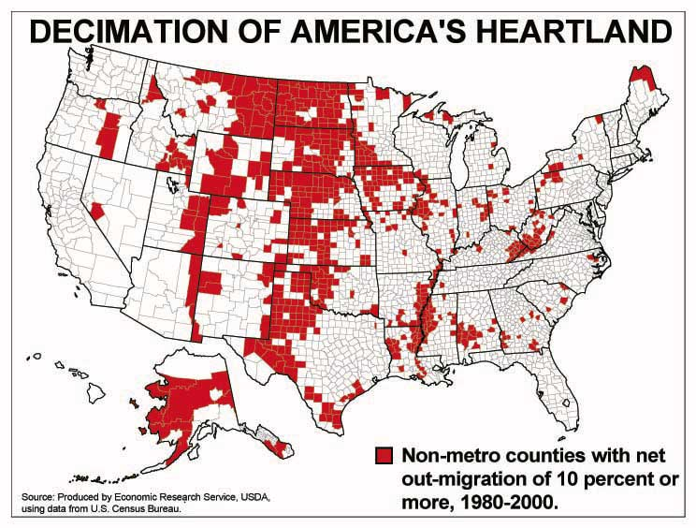
Population of the Great Plains
Two words: Rural and declining.

Slide 36
Mountain and Basin States
States included: New Mexico, Colorado, Wyoming, Montana, Idaho, Utah, Nevada, Arizona
Transitions: Colorado, Wyoming and Montana are also Great Plains States
Southwest: Texas, New Mexico, Arizona, Southern Utah/Nevada.

Slide 37
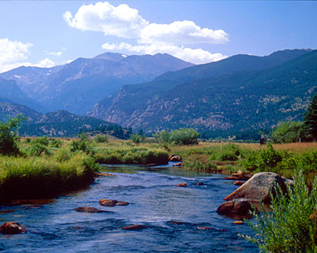
Physical Geography
Characterized by the steep and jagged Rocky Mountain Range.

Slide 38
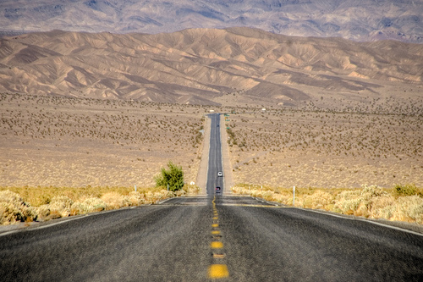
Climates
Highland climate is found throughout the Rockies
Deserts
In general, the area is
arid.
Farming is done
with irrigation.

Slide 39
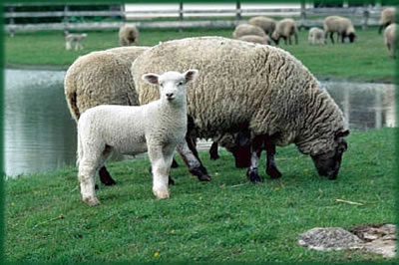
Historical Geography
Mining towns
Outlaws (Wild West)
Cattle/Sheep Grazing
Reservation Lands
Las Vegas and Reno-
Gambling towns
National Park Service

Slide 40
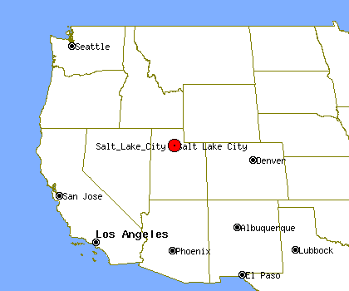
Population Geography
Not densely populated.
Major urban centers include: Denver, Salt Lake City, Phoenix.

Slide 41
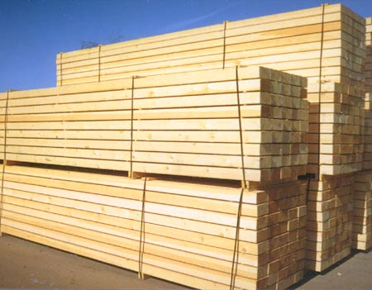
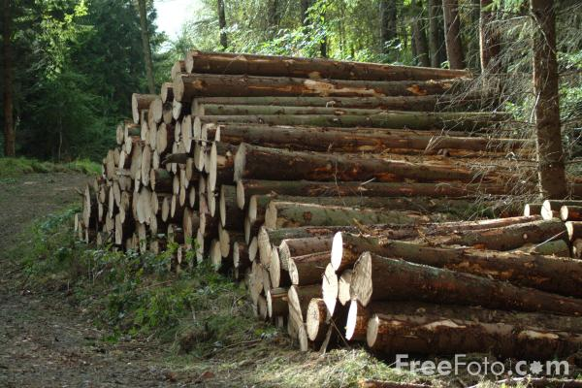
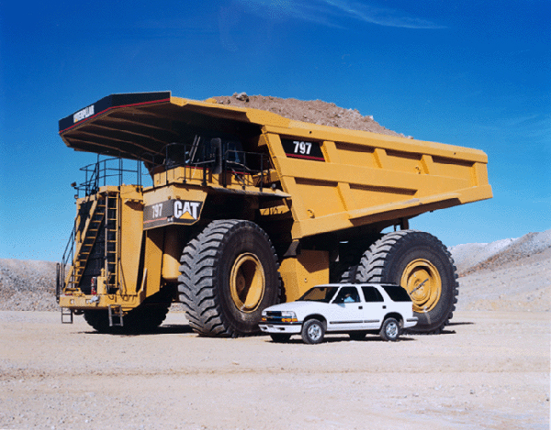
Economic Activity
Grazing
Mining
Tourism
Lumber

Slide 42
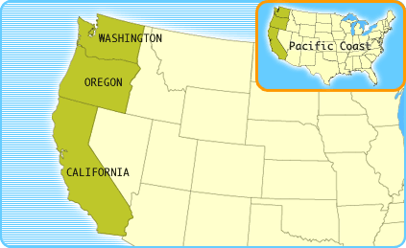
Pacific Coast States
California, Oregon and Washington

Slide 43
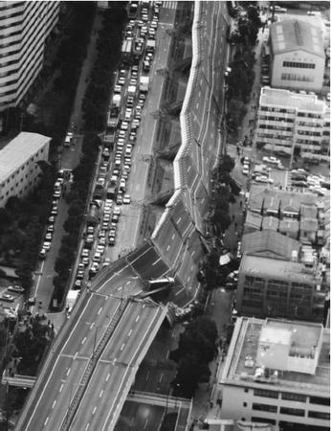
Physical Geography of West Coast
Mountain Ranges (Sierra Nevada and the Cascades) and Rocky coastlines due to subduction forces.
Physical hazard exist across
the region due to tectonic forces.

Slide 44
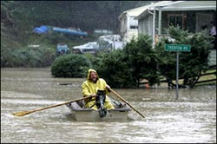
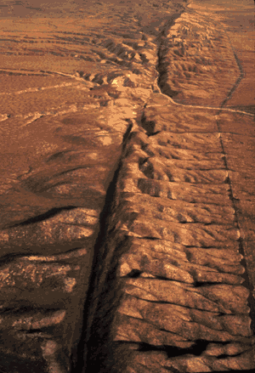
Southern California
The continual presence of natural hazards, including fire, flood, earthquakes, and intense drought, has done little
to reduce the growth of this
area
San Andreas Fault
Los Angeles is the 2nd largest
city in the U.S.

Slide 45
Population Geography
More dense along the coastal areas, especially between San Diego, LA, and San Francisco.
Other urban centers exist around Seattle and Portland.

Slide 46
Economic Activity
Movie Industry
Wine (Napa and Sonoma)
Tourism
Fishing on the coast

Slide 47
Western Politics
The West coast states are known for their liberalism in politics.
Examples: Oregon has legalized euthanasia, all have legalized medicinal marijuana, California recognizes same-sex marriage

